Slide 1
Subject : Data Structures Subject_code : CS-250 Course : B.Tech.(III Sem.)
By
Poonam Saini
Department of Computer Science & Engineering
Sir Padampat Singhania University
Udaipur

Slide 2
Introduction to Data Structures
This work is licensed under a Creative Commons Attribution-ShareAlike 4.0 International License. This presentation is released under Creative Commons-A6ribute,on 4.0 License. You are free to use, distribute and modify it ,
including for commercial purposes, provided you acknowledge the source.

Slide 3
Recommended Text Books
Langsam, Tanenbaum, “Data Structures Using C and C++”, Prentice Hall.
Seymour Lipschutz, “ Theory And Problems of Data Structures”, Schaum’s Outline Series

Slide 4
Reference Books
Alfred V. Aho, Jaffery D. Ullman, John E.Hopcroft, “Data Structures and Algorithms”, Addison-Wesley
Allen L. Weiss, “Data Structures and Algorithm Analysis in C”
Robert Lafore, “Data Structures and Algorithms in 24 Hours”, SAMS

Slide 5
Goals of this Course
The objective of this course is to introduce the analysis and designing of data structures using various standard algorithms.
Cover well-known data structures such as dynamic arrays, linked lists, stacks, queues, trees and graphs.

Slide 6
Learning Objectives
What is a Data Structure?
Need of a data structure
Data representation
Abstract Data Types
Refinement stages of a complex problem

Slide 7
Introduction
Data
It is a value or a set of values of different types called data type like string, integer etc.
Structure
It is a way of organizing the information so that it becomes easy to use or it is a set of rules that hold the data together.
Data Structure
It is an aggregation of atomic and composite data types into a set with defined relationship.

Slide 8
Data Structure
A computer is a machine that manipulates data.
The prime aim of data structure includes:
- To study how data is organized in a
computer
- How it is manipulated
- How it is retrieved
- How it can be utilized, resulting in more
efficient programs.

Slide 9
What is a Data Structure ?
In computer science, a data structure is a particular way of storing and organizing data in a computer so that it can be used efficiently.
Data may be organized in many different ways, the logical or mathematical model of a particular organization of data in memory or on disk is called Data Structure.
Algorithms are used for manipulation of data.

Slide 10
Reflection Spot - Think & Write
You are currently watching a recorded video.
Question:
What are the operations that can be performed on data structures?
Note: Pause the video and write the answer and play to continue.

Slide 11
Data Structure Operations
The data appearing in our data structure is processed by means of certain operations. In fact, the particular data structure that one chooses for a given situation depends largely on the frequency with which specific operations are performed. The following four operations play a major role:
Traversing: Accessing each record exactly once so that certain items in the record may be processed.(This accessing or processing is sometimes called 'visiting" the records.)

Slide 12
Data Structure Operations
Searching: Finding the location of the record with a given key value, or finding the locations of all records, which satisfy one or more conditions. Inserting or Adding new records to the structure. Deleting or Removing a record from the structure.
Insertion: Adding a new record to the structure.
Deletion: Removing a record from the structure.

Slide 13
Need of a Data Structure
To solve the complex requirements in efficient way.
Provide fastest solution of human requirements.
Provide efficient solution of complex problem.
A data structure helps in understanding: The relationship of one data element with the other and How the data should be organized within the memory?

Slide 14
Need of a Data Structure
Therefore, a data structure helps you to
Analyze the data
Store that data
Organize that data in a logical or mathematical manner.

Slide 15
Types of Data Structures
Linear Data Structure: A data structure is said to be linear if its elements form a sequence, or in other words a linear list. Eg. Array, Stack, Queue, Linked List
Non-Linear Data Structure: A non-linear structure is mainly used to represent data containing a hierarchical relationship between elements. Eg. Tree, Graph

Slide 16
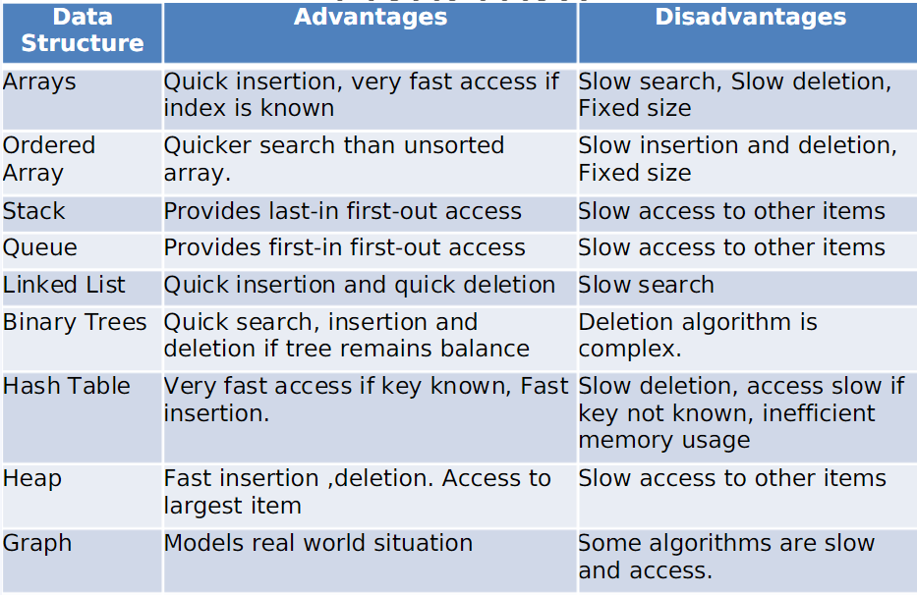
Characteristics of Data Structures

Slide 17
Data Representation
The basic unit of a data representation in a computer is a bit which can be either 0 or 1.
Basic data types of any language
- Integer representation
- Real No. representation
- Character representation

Slide 18
Data Type
It consists of two parts, a set of data and the operations that can be performed on the data. Data types facilitate the optimum use of memory as well as a defined way to interpret.
Atomic data type: It is a set of atomic data with identical properties. It has a set of values and a set of operations that are to be performed on it. For eg.:
Values: -∞, …, -2, -1, 0, 1, 2, ….., ∞
Operations: *, +, -, %, /, ++, - -

Slide 19
Data Type
Composite data type: It is the opposite of atomic data type. Composite data can be broken out into subfields that have meaning. For eg.: Enrollement No: 18CS00001, address etc.

Slide 20
Abstract Data Type
It is defined as a mathematical model of the data objects that make up a data type as well as the functions that operate on these objects.
An abstract data type is a data declaration packaged together with the operations that are meaningful for the data type.
We know what a data type can do but how it is done is hidden i.e. known as the concept of abstraction.

Slide 21
Primitive Data Type
These are the basic data types of any language that form the basic unit for the data structure defined by the user.
It defines how the data will be internally represented in, stored and retrieved from the memory.
For eg.: int, char, float

Slide 22
Difference between ADT, data Type and Data structure
An ADT is the specification of the data type which specifies the logical and mathematical model of the data type.
A data type is the implementation of an abstract data type.
Data structure refers to the collection of computer variables that are connected in some specific manner.

Slide 23
Refinement Stages to solve a complex problem
The best approach to solve a complex problem is to divide it into smaller parts such that each part becomes an independent module which is easy to manage.
Different problems have different no. of refinement stages, but in general there are four levels of refinement processes.

Slide 24
Refinement Stages to solve a complex problem
Conceptual or abstract Level
At this level, we decide how the data is related to each other and what operations are needed.
2. Algorithmic or Data structure level
At this level, we decide, what kind of data structure will be required to solve the problem. For eg. Contiguous list for retrieving any element or stacks for evaluation of a prefix/ postfix notation.

Slide 25
Refinement Stages to solve a complex problem
3. Programming or Implementation level
At this level, we decide the details of how the data structures will be represented in the computer memory. For eg. We decide whether the linked lists will be implemented with pointers or with the cursors in an array.
4. Application level
This level settles all the details required for particular application such as names for variables or special requirements for the operations imposed by applications.

Slide 26
Refinement Stages to solve a complex problem
3. Programming or Implementation level
At this level, we decide the details of how the data structures will be represented in the computer memory. For eg. We decide whether the linked lists will be implemented with pointers or with the cursors in an array.
4. Application level
This level settles all the details required for particular application such as names for variables or special requirements for the operations imposed by applications.

Slide 27
Thank You

